Slide 1
A DATA SCIENCE PROJECT BIKE RENTALS
Team Members
1. Abdul Aamir khan
2.Durga prasad kamisetty
3.Swapnil Chavan

Slide 2
WHAT IS BIKE RENTALS SYSTEM AND WHY IS IT IMPORTANT ???
A bike rental system is a service where bicycles are made available for short-term use, typically for a fee. These systems can be found in various forms, from docked stations where bikes are picked up and returned at designated locations, to dockless systems where bikes can be picked up and dropped off anywhere within a specified area using a mobile app.
Sustainable Transportation: Bike rental systems promote sustainable transportation by offering an eco-friendly alternative to cars and public transportation. Biking reduces carbon emissions and traffic congestion, making cities cleaner and more livable.
Last-Mile Connectivity: Bike rentals provide a convenient solution for covering short distances between public transit stops and final destinations. This "last-mile" connectivity improves overall transportation efficiency and encourages the use of public transit.
Health and Fitness: Cycling is a great form of exercise, promoting physical fitness and well-being. Accessible bike rental systems encourage people to incorporate physical activity into their daily routines, contributing to healthier lifestyles.

Slide 3
HOW IT WORKS ….
Understanding the objectives
Importing the necessary libraries
Loading the Dataset
Data Understanding
Data preprocessing
Exploratory Data Analysis (EDA)
Data Visualization
Feature Scaling
Model Building using different Classification Algorithms
Model Training and Testing
Model Deployment

Slide 4
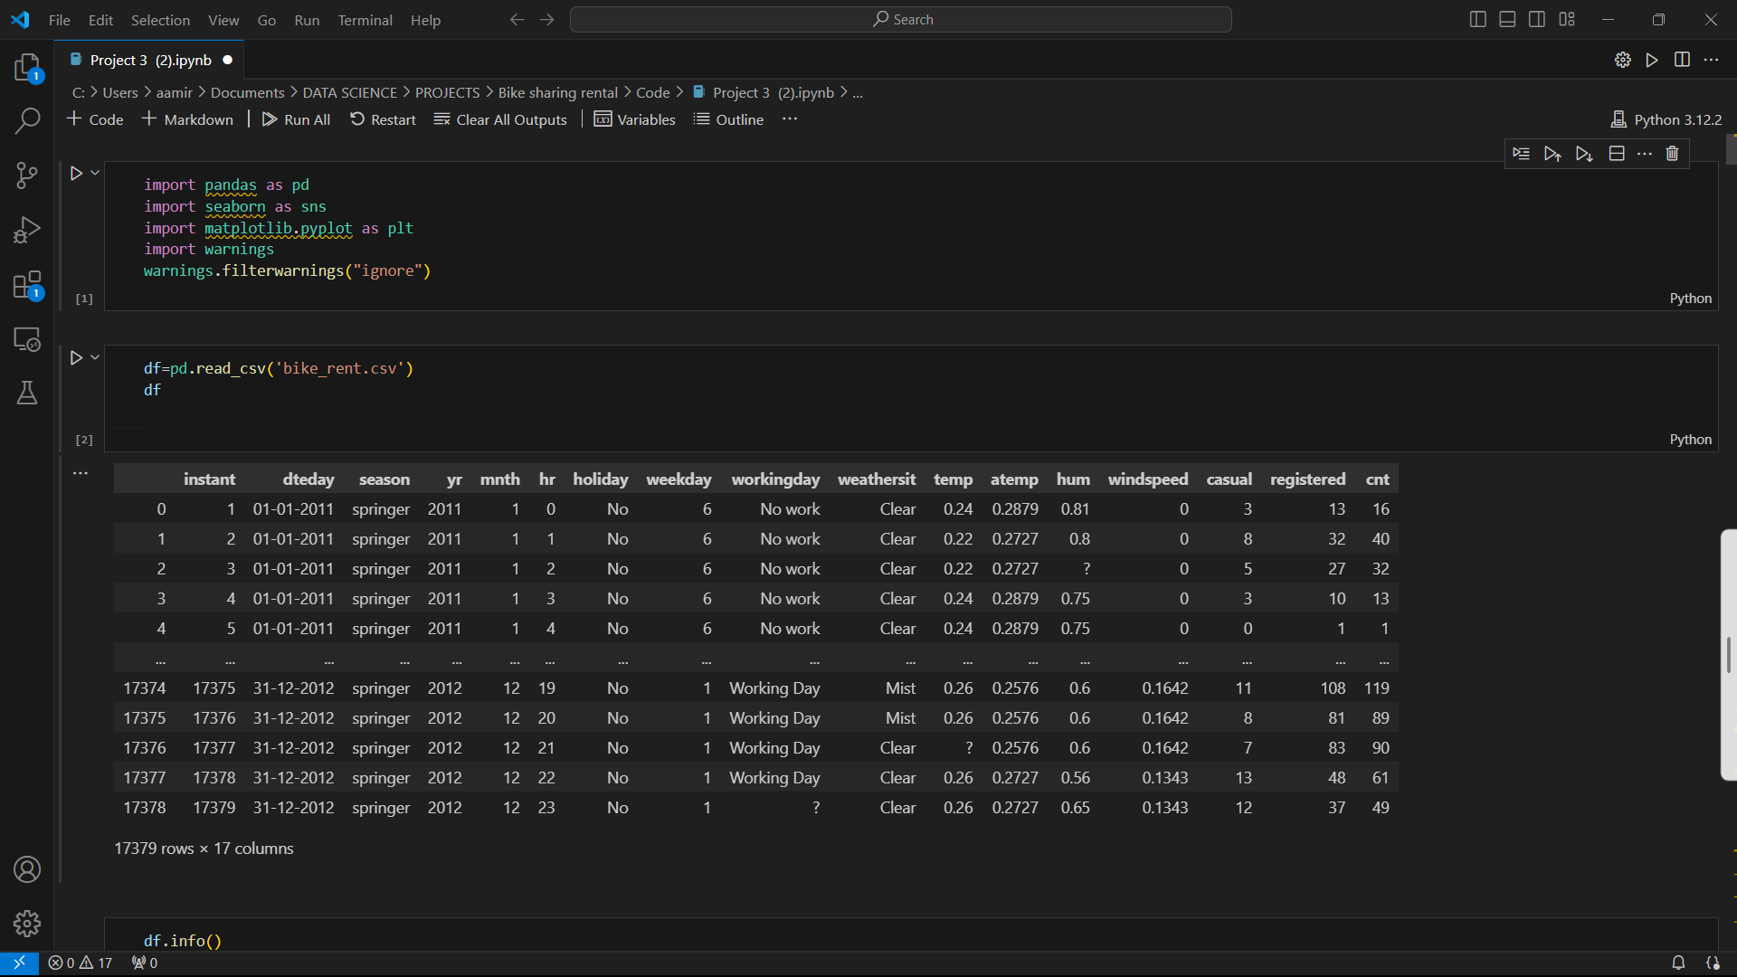
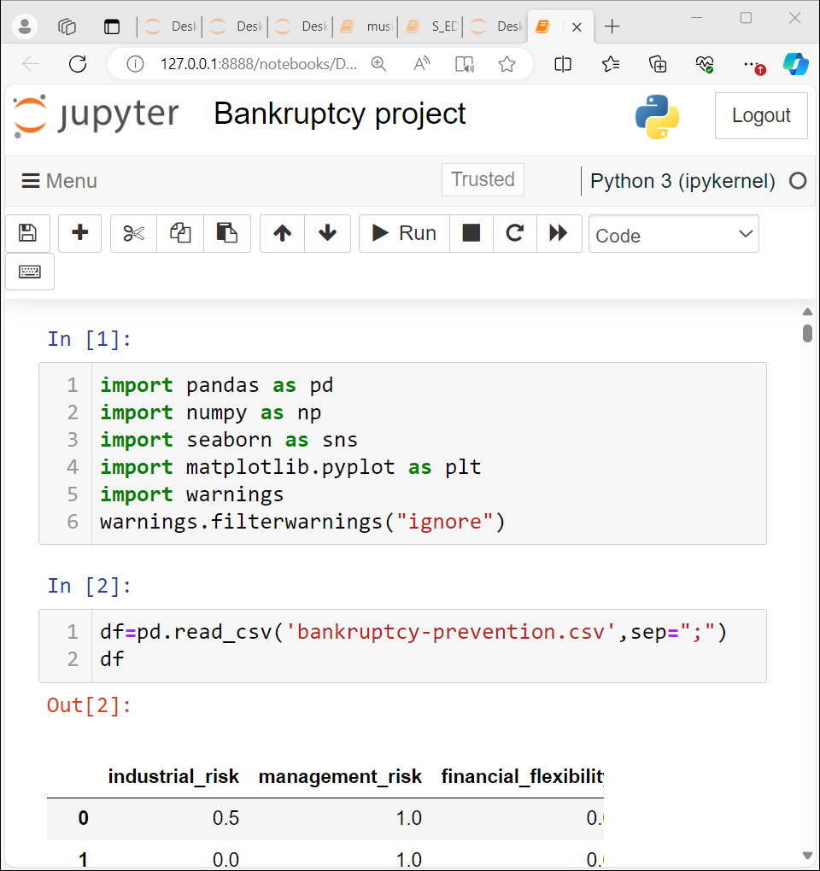
After understanding the objective of the project and then importing libraries ,we will import the required dataset in csv format.

Slide 5
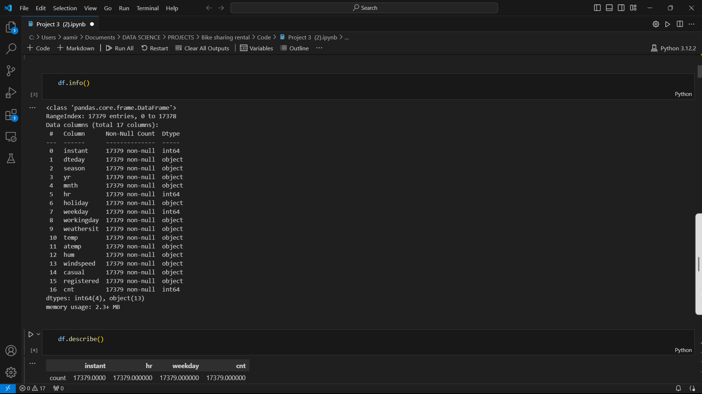
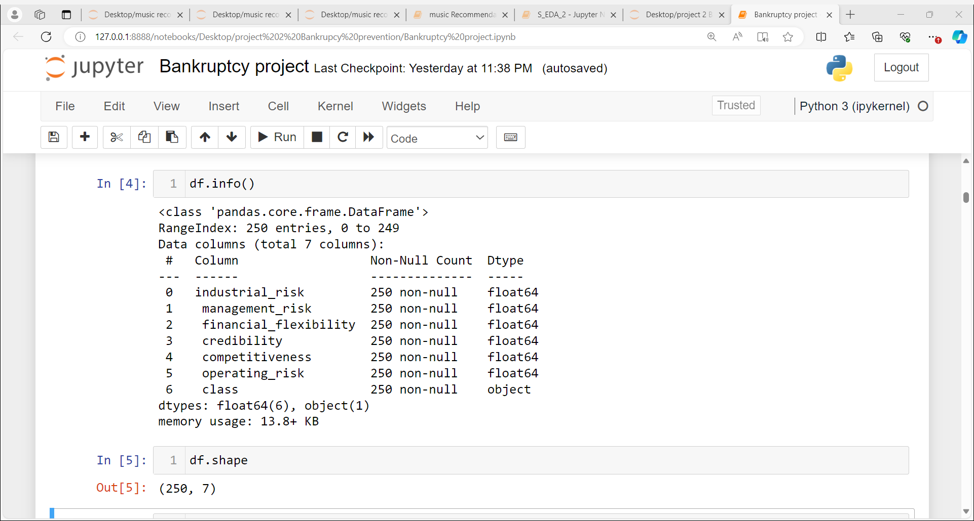
EXPLORATORY DATA ANALYSIS AND DATA PREPROCESSING

Slide 6
UNDERSTANDING THE INFORMATION
As we can explained before the data has total 17 features at six are independent and 17th is the dependent feature.... (Target variable)
It dose not contain any null values ..all the independent variables have data type – float
Only target variable has int datatype which is numeric..

Slide 7
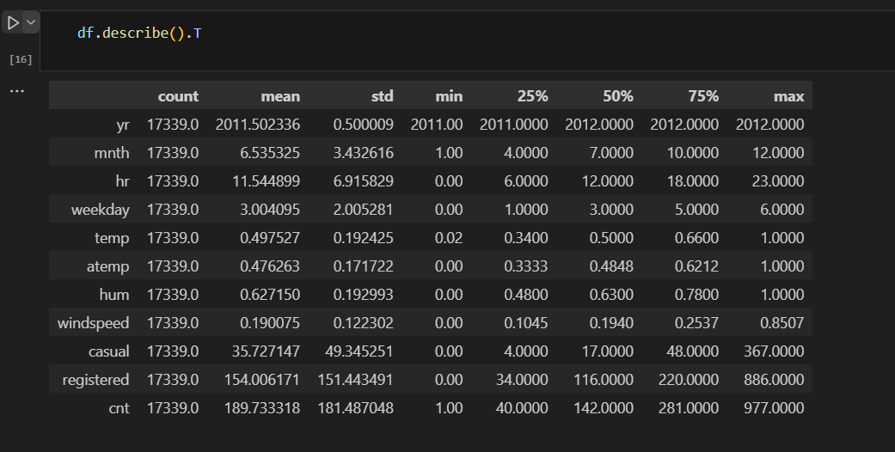
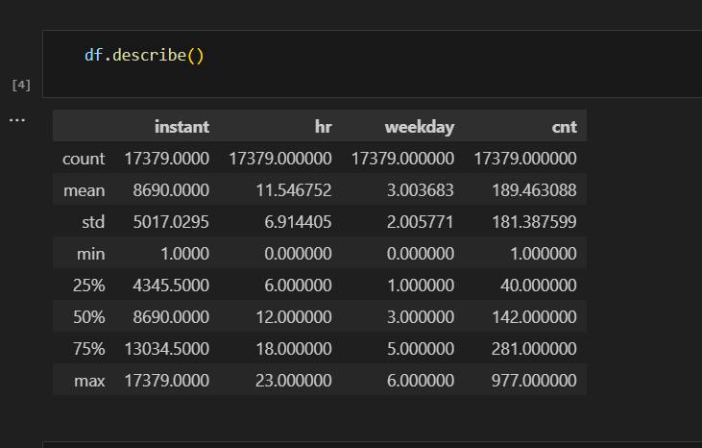
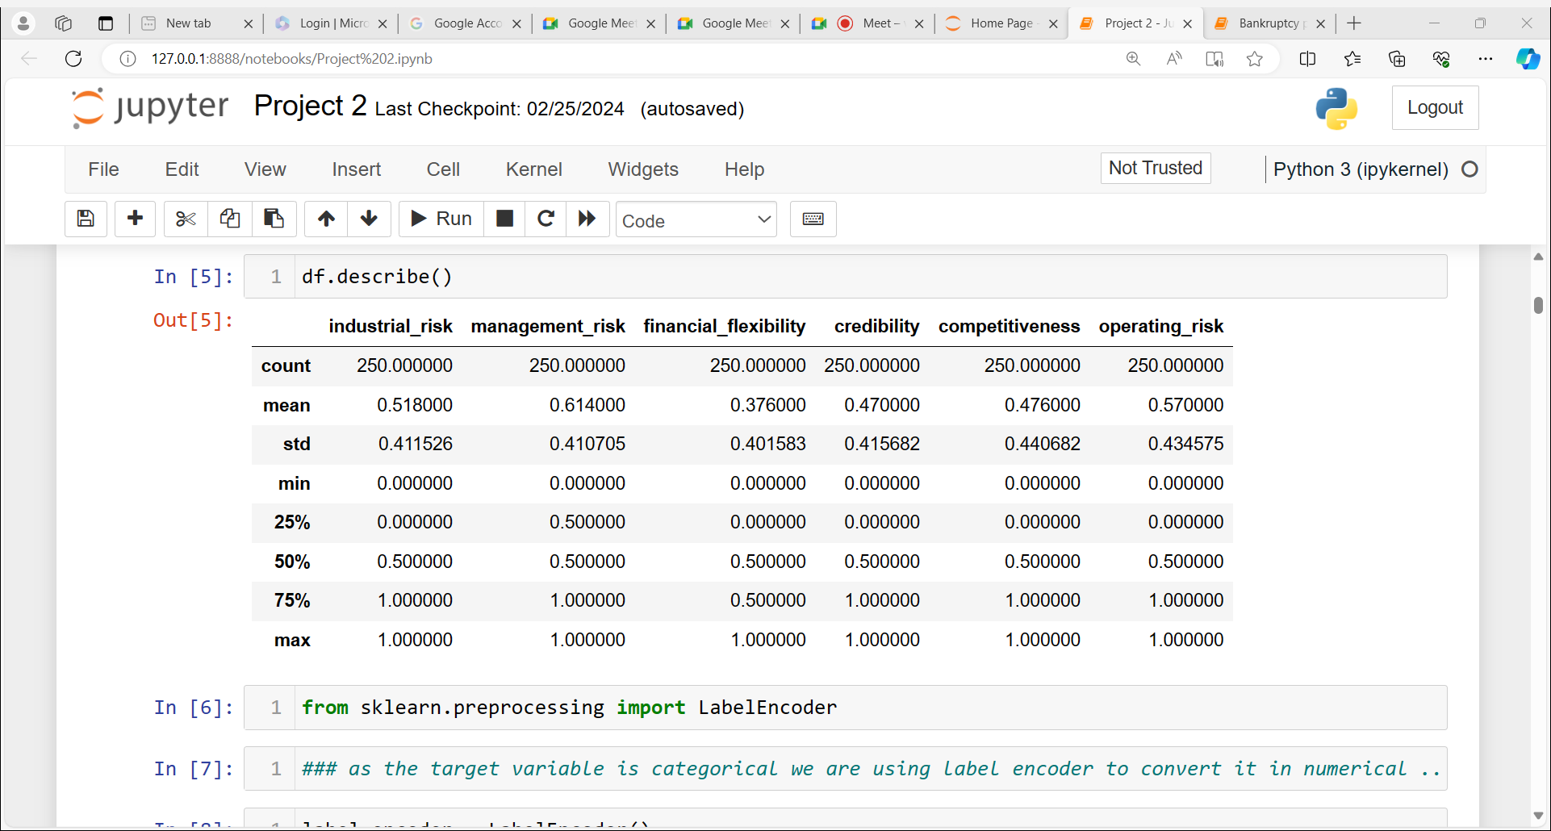
DESCRIPTIVE ANALYTICS

Slide 8
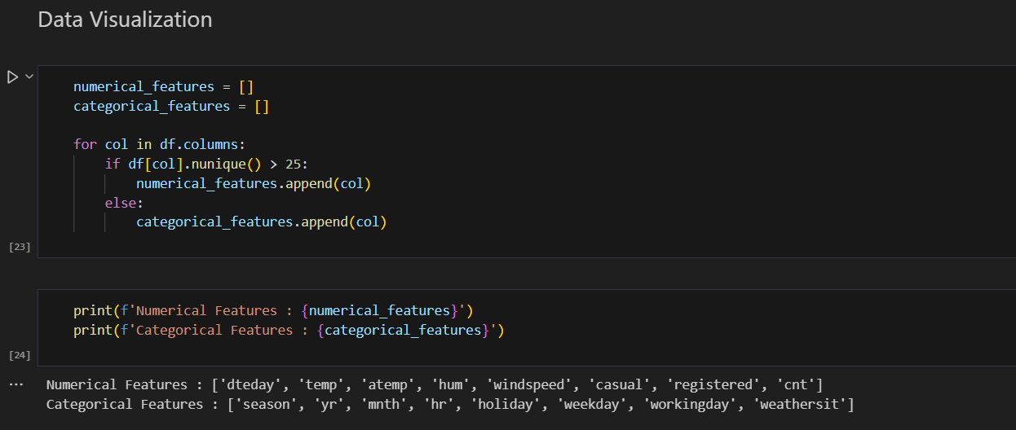
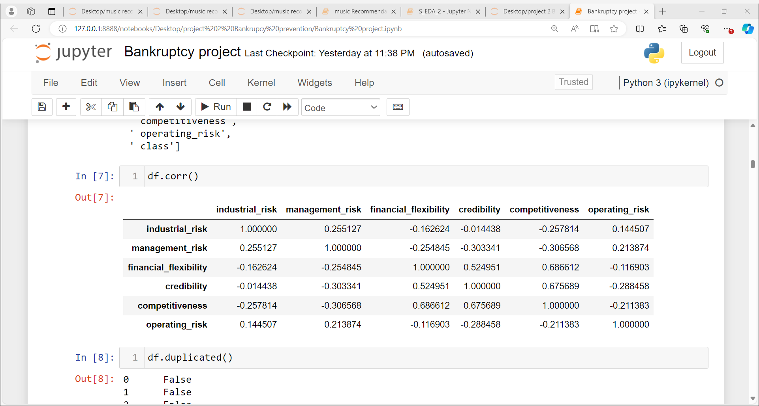
DATA VISUALIZATION

Slide 9
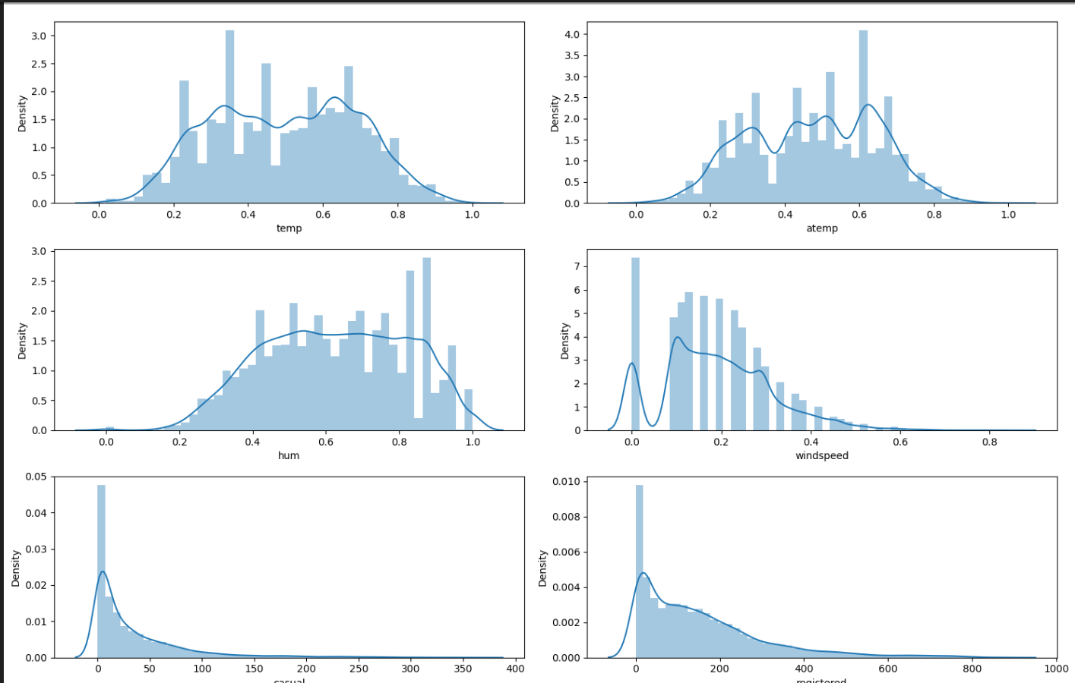
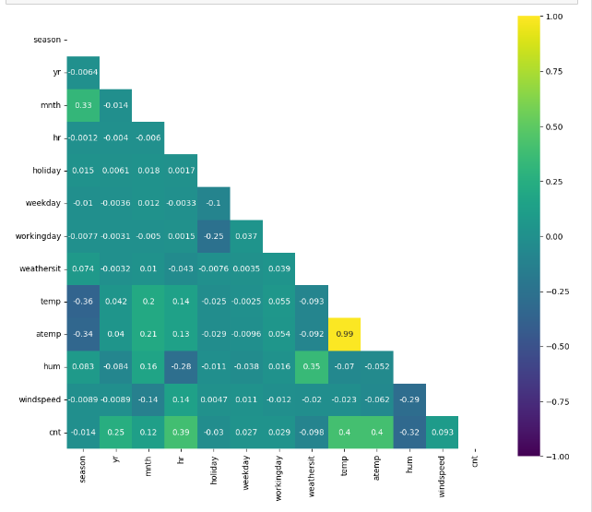
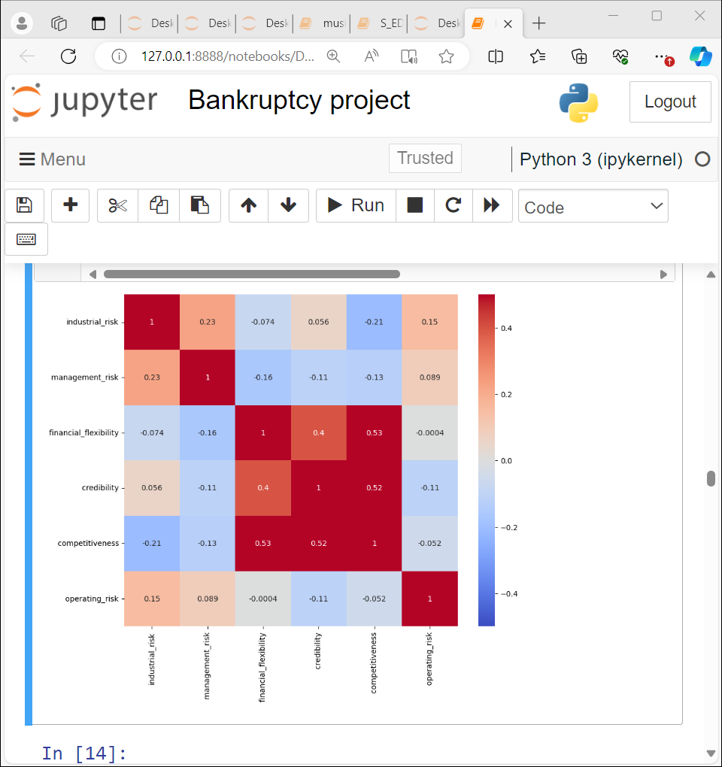
HEAT MAP

Slide 10
INFERENCE THROUGH HEATMAP
### looking at the above heatmap we can infer that -- temp and atemp is negligibly co related with other variables as well as within them selves ....
### finantial flexibility is highly and positively co related with competitiveness which is 0.99 and it has positive corelation with credibility which is 0.25
### credibility again has strong finantial flexibility and compitiveness

Slide 11
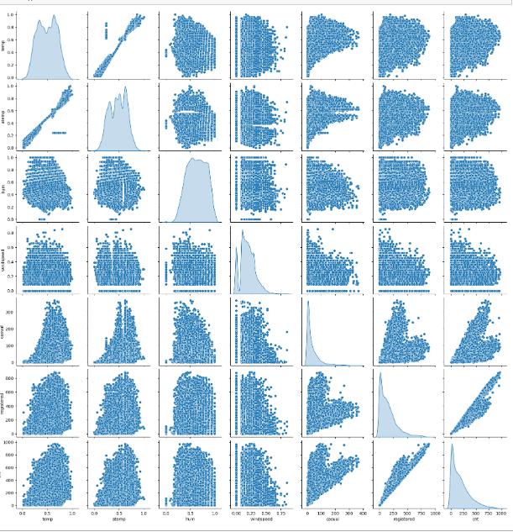
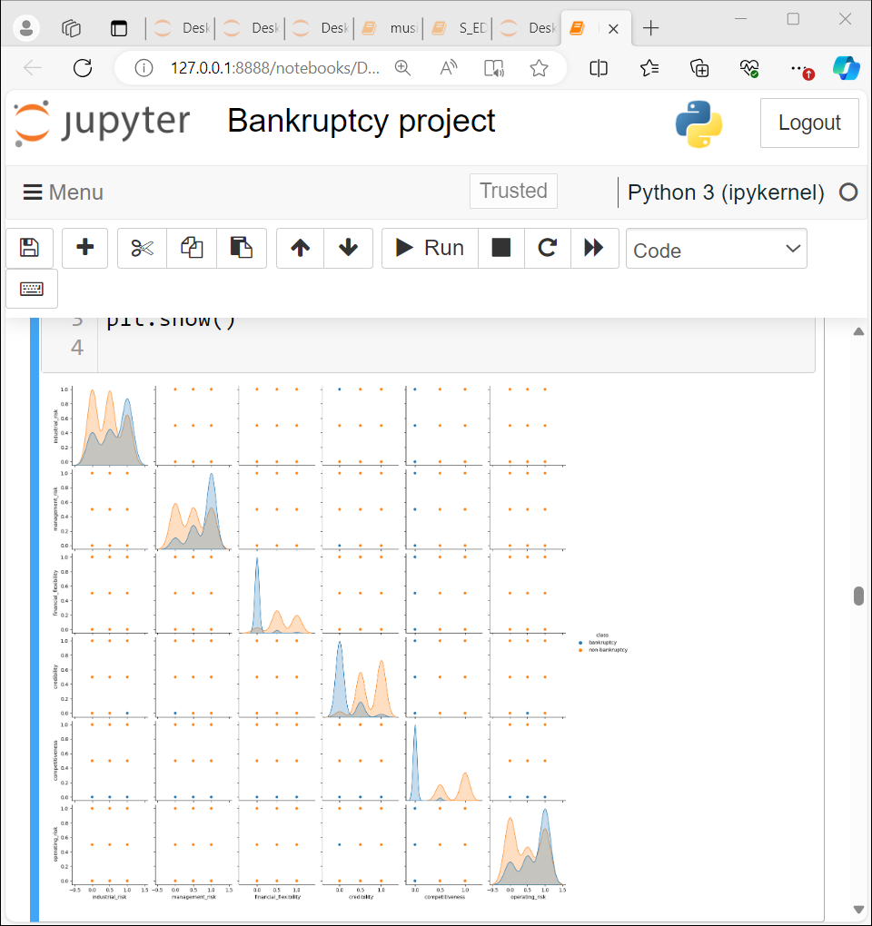
PAIRPLOT
Here pair plot shows no relation between variables clearly…..

Slide 12
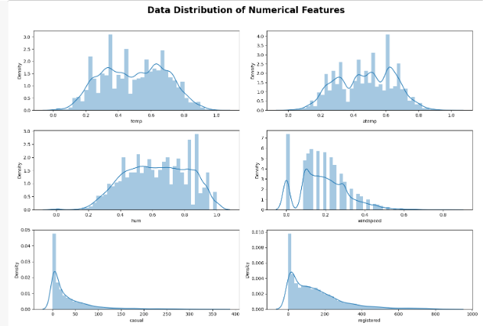
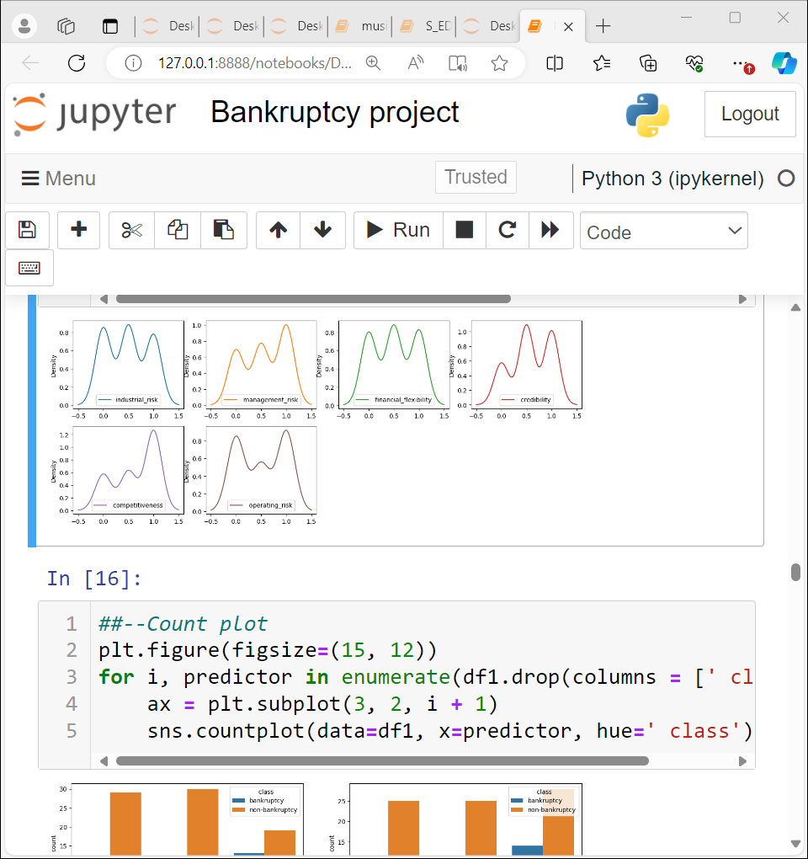
DATA DISTRIBUTION
All the features are showing mainly three types of distribution as all the features are mainly divided in three categories…..which is 0.5,0,and 1

Slide 13
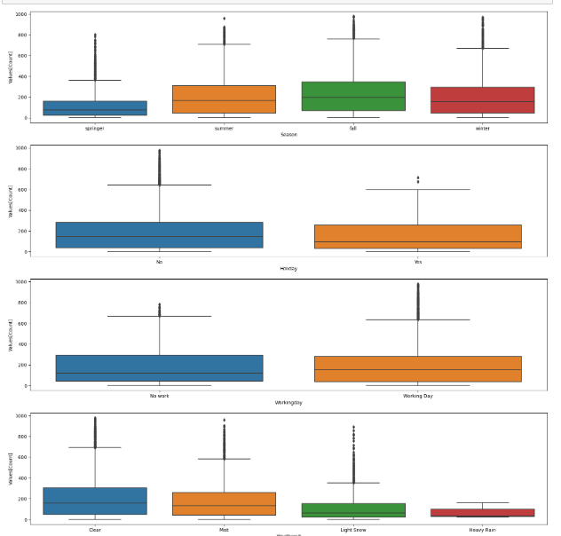
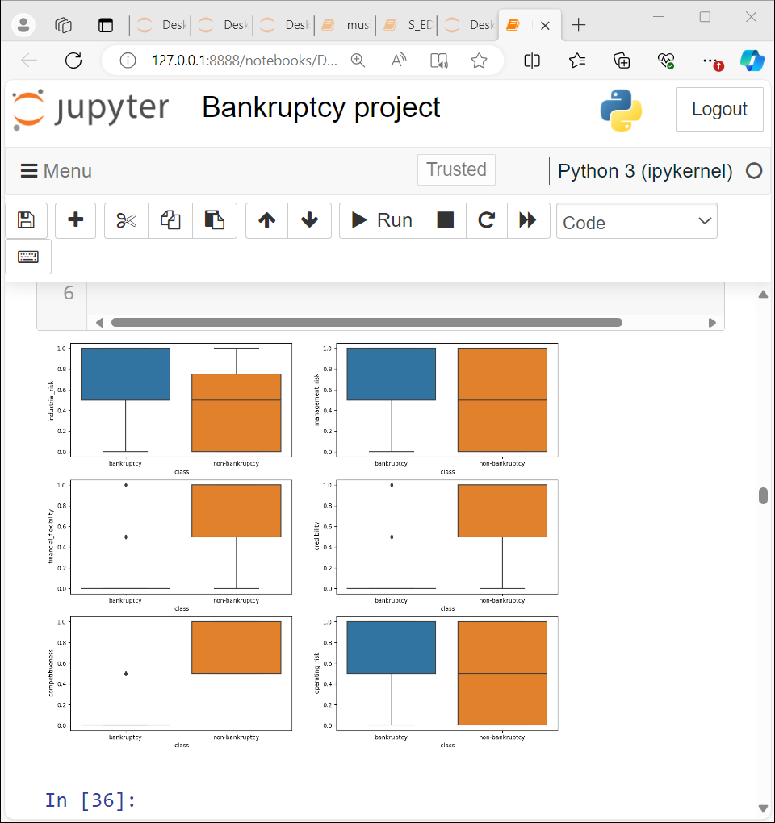
BOX PLOT
As per the boxplots outliers are detected in this data….

Slide 14
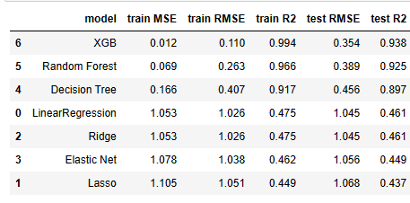
MODEL BUILDING
Being binary classification project we tried different models for classification like linear regression, decision tree , random forest, XGBoost , Ridge ,Elastic net, and Lasso from ensemble technique…accuracy of each model is as follows…
Model | Avg Training Accuracy | Avg Testing Accuracy
Logistic Regression | 0.996 | 0.996
KNN | 0.994 | 0.991
Navie Bayes | 0.979 | 0.977
SVM | 1.00 | 0.995
Decision Tree Classifier | 1.0 | 0.99
Bagging Classifier | 0.999 | 0.989
Random Forest Classifier | 1.0 | 0.993

Slide 15
Here for each model total 100 iterations are done and train and test errors has been derived accordingly (by taking avg of all 100 iterations)..
As almost all models are giving near to 100 % of accuracy moreover in each model training and testing error are different in each model….
Out of all models we have decided to select XGBoost for the model as its giving maximum accuracy for both training and testing data set …

Slide 16
DEPLOYING THE SYSTEM
Selecting an appropriate deployment platform
Scaling the system for large user bases
Ensuring system stability and reliability
Find out how we ensured the scalability of our system to cater to a growing user base.
Choose the ideal platform to deploy our bike rental
system for maximum accessibility.
Learn about the measures taken to maintain the availability of the vehicles .

Slide 17
For deployment stream lit is used for following reasons…
It requires few line of code to build an app
Dose not require any web development knowledge
Deploy the code immediately and see the changes immediately by saving the source code…
Its an open source framework

Slide 18
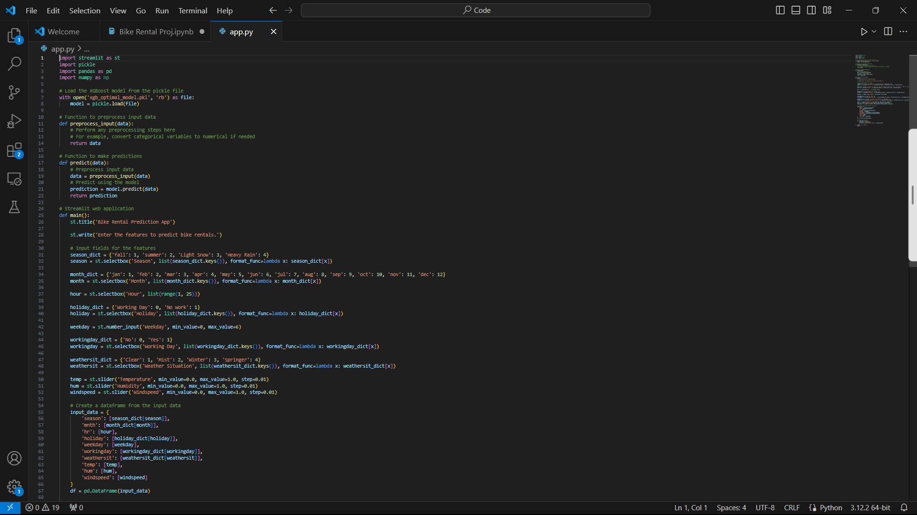
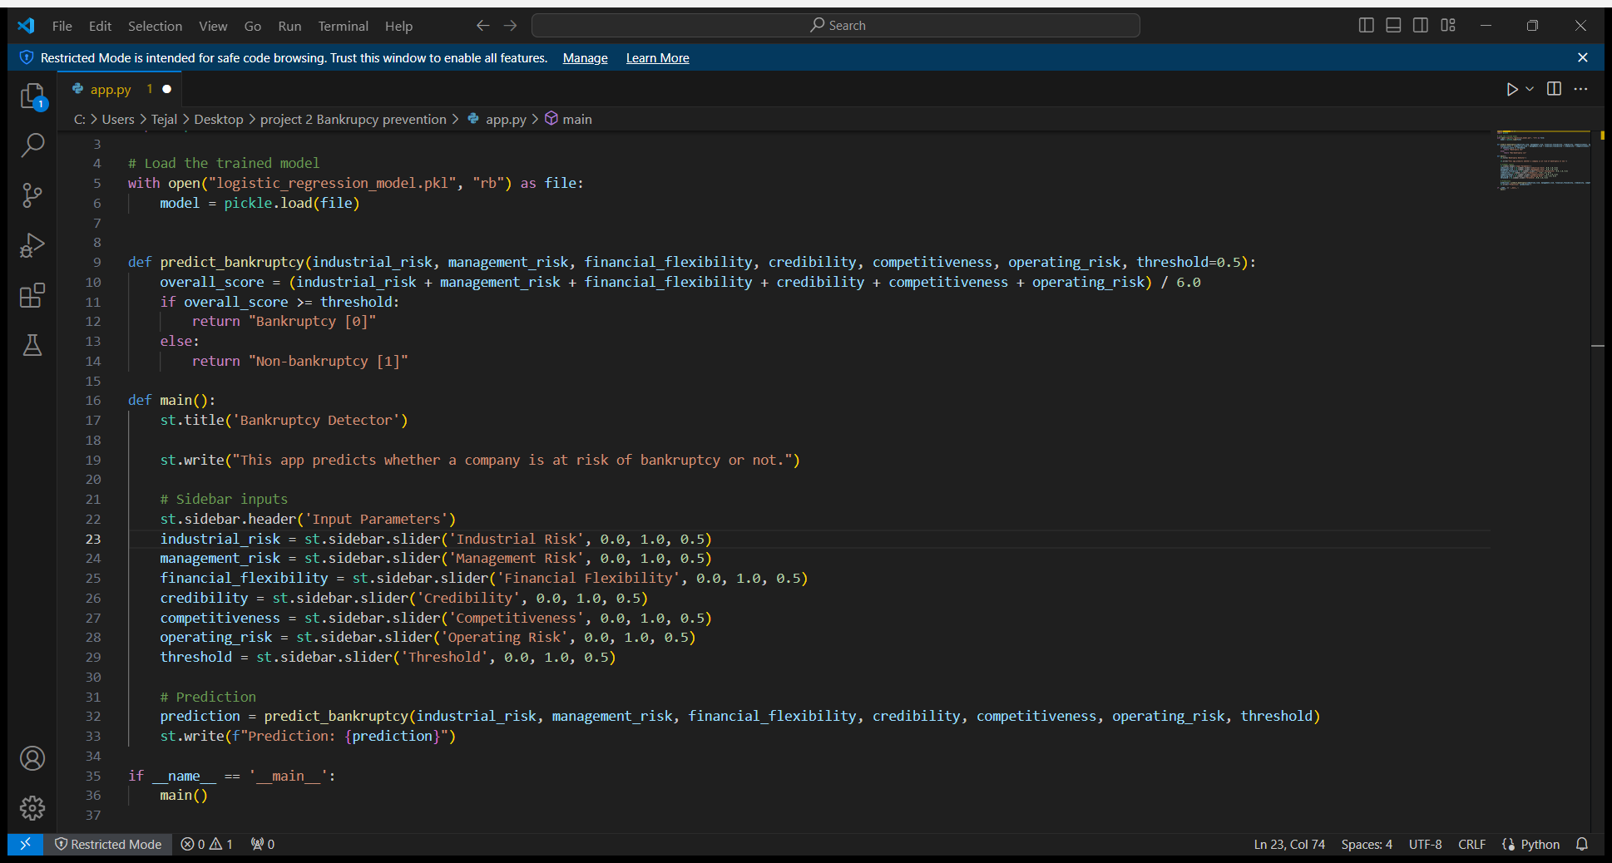
IMPORTING AND RUNNING STREAMLIT

Slide 19
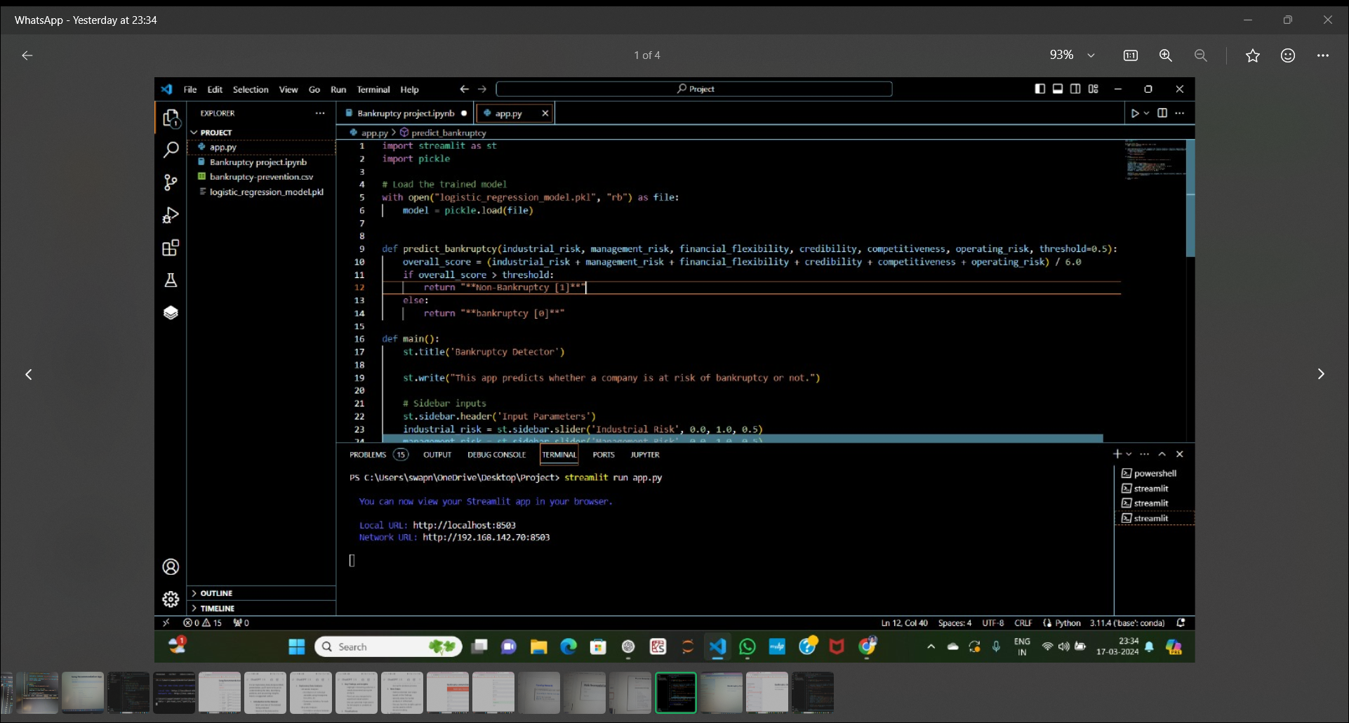
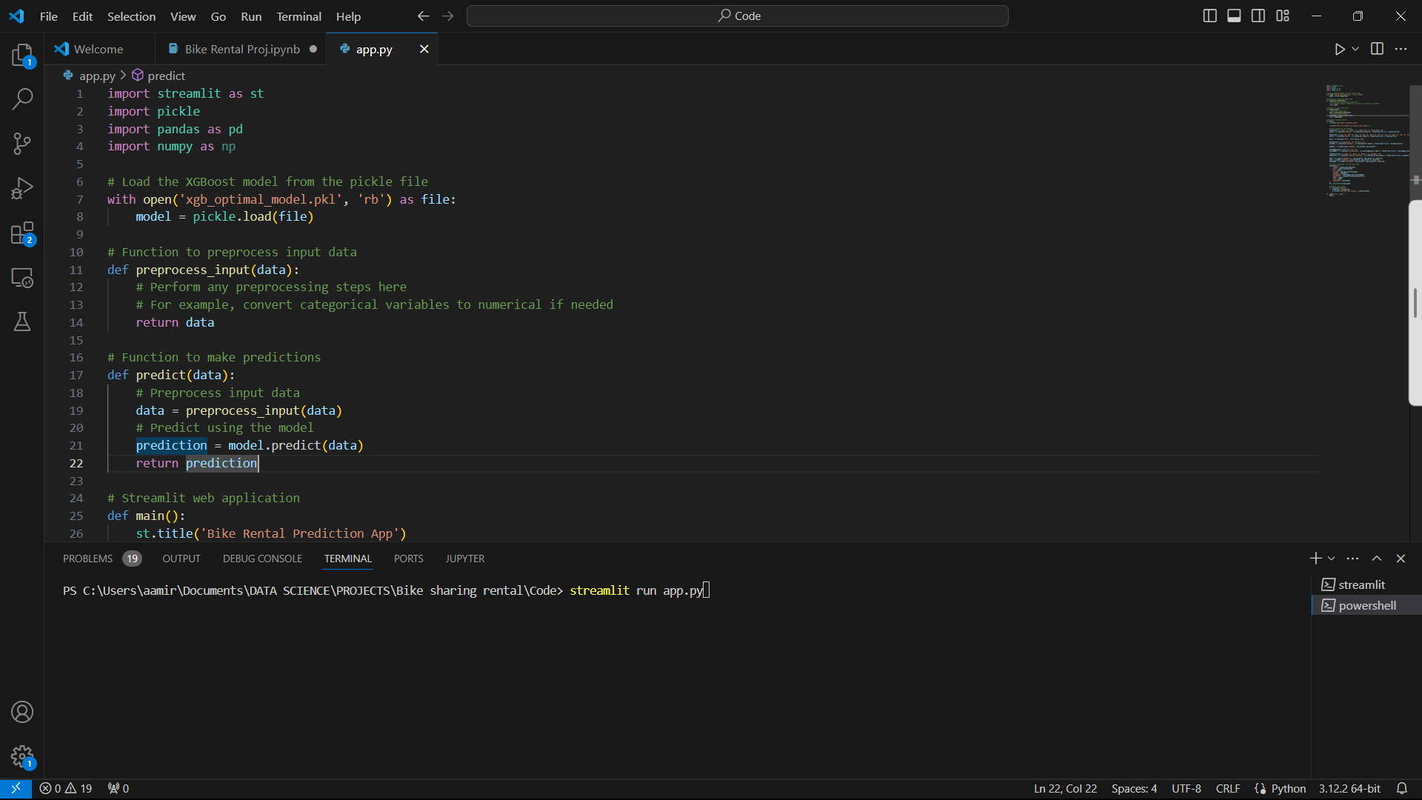
For deployment streamlit is used for following reasons…
It requires few line of code to build an app
Dose not require any web development knowledge
Deploy the code immediately and see the changes immediately by saving the sourse code…
Its an open source framework

Slide 20
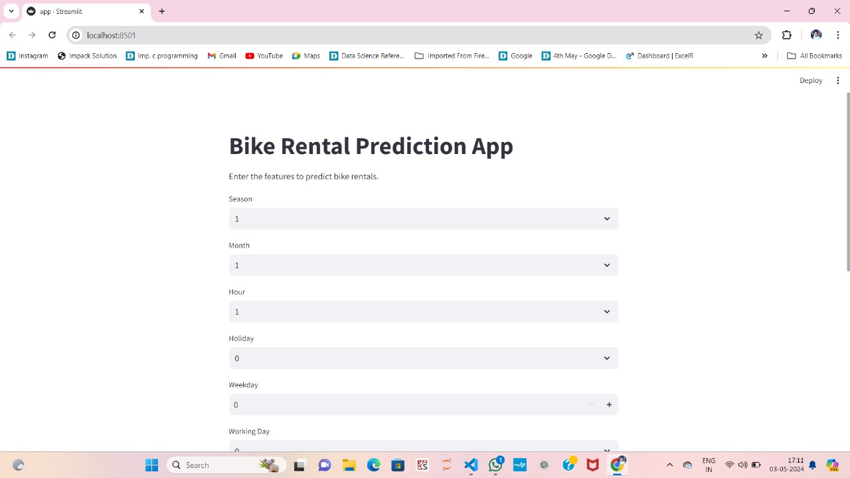
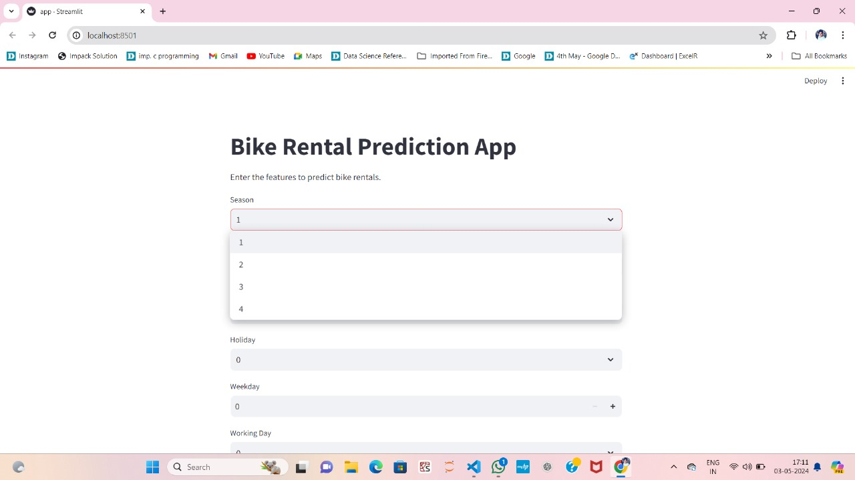
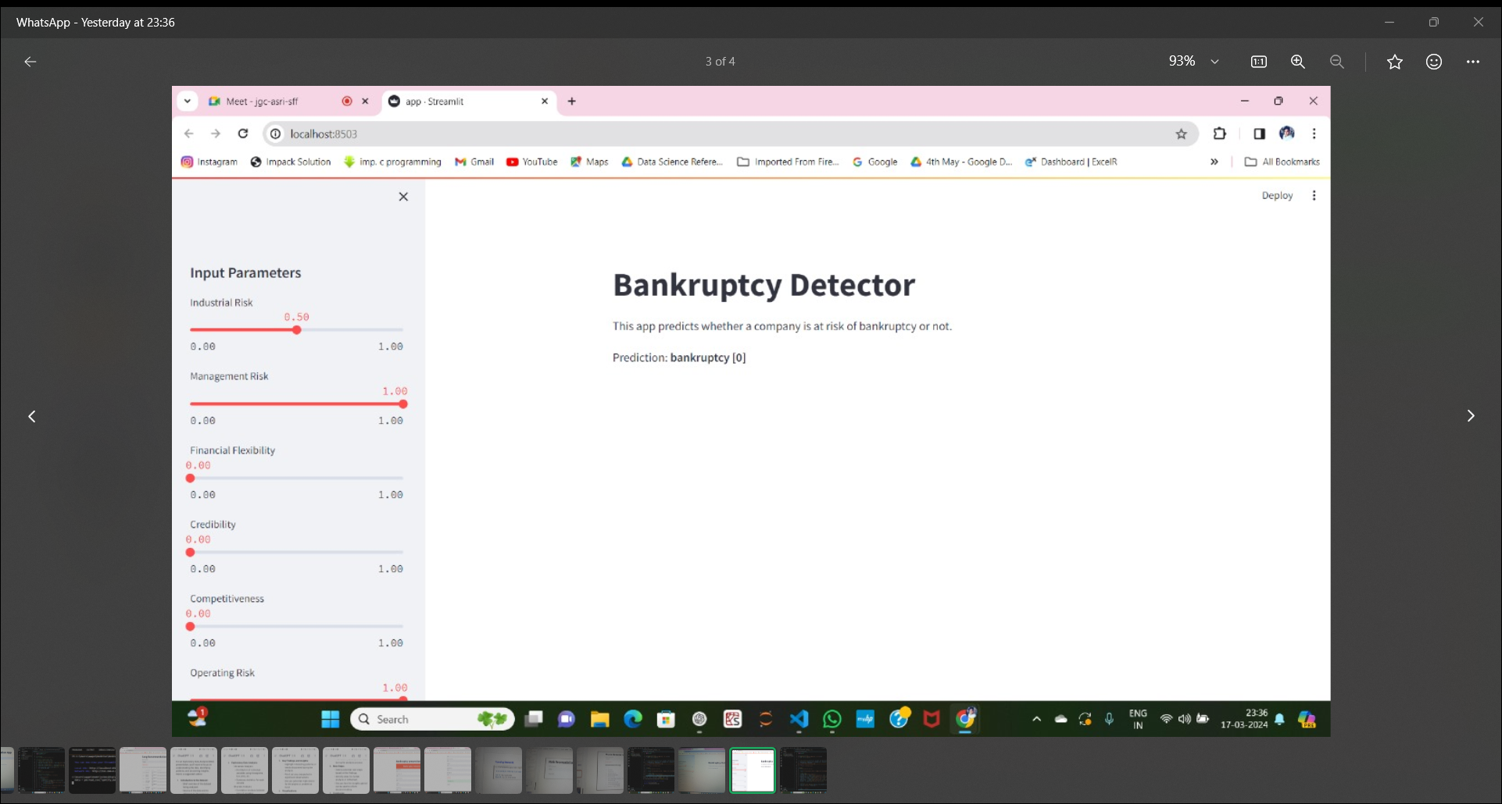

Slide 21
LEARNINGS
The project provided us very best opportunity to learn about different aspects of data mining ,data cleaning ,visualization ,model building based on classification and a lot more.. We could explore classification at depth …
Such type of prediction system is extremely important for our economic system as it can help in prevents. And thus preventing financial turmoil.

